Slide 1
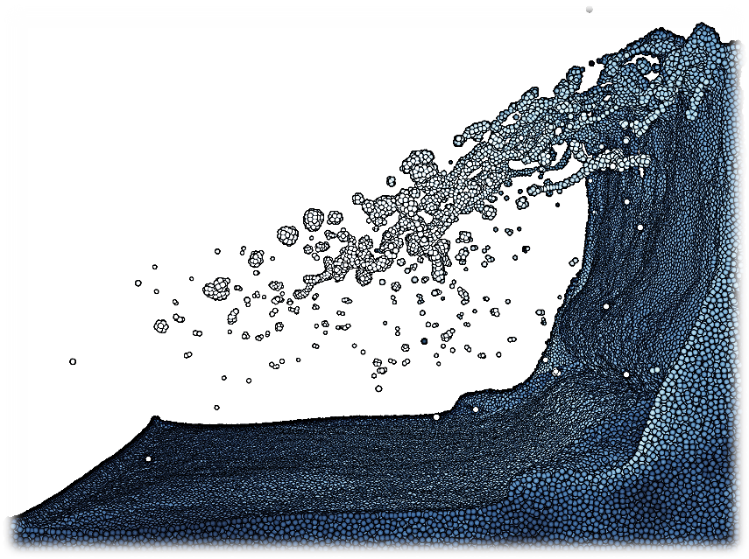
Haptic Particle Simulations
M.Tech 1st Stage Project
Dwaipayan Sardar * | 143079009
GUIDE: Prof. Subhasis Chaudhuri *
EXAMINAR: Prof. Abhishek Gupta #
* - Department of ElectricalEngineering, IIT Bombay
# - Department of Mechanical Engineering, IIT Bombay
VIP Lab
EE, IIT Bombay
R. Winchenbach and et al, “Constrained Neighbor Lists for SPH-based Fluid Simulations“, ACM SIGGRAPH 2016

Slide 2
Motivation
It’s need:
Natural alike interactive simulation
Particle dynamics is favorable in modelling a wide variety of objects [Macklin ‘14]
Adds an edge in fluid and deformable object rendering
Above materials finds use in tissue & bio-fluid modelling and VR games
How it is achieved?
DEM and SPH techniques for particle physics modelling
Considering independent particles: leveraging extensively parallel GPU architecture
High DoF Haptics point devices and open source C++ libraries fro interfacing them

Slide 3
Particle simulations: overview
Obejective: Simulation of fluids composed of particles
Methods:
Discrete Element Modelling – Lagrangian based
Assumptions:
A set of particles enclosed in a hollow volume
Collide inelastically with immediate neighbors: particles, colliders and bounding walls
No gravitational attraction is considered among the particles, though a constant global gravity affects the overall system
A global damping is added to render a smooth effect of atmosphere
Eulerian | Lagrangian
Workspace is discretised into grid | Material is discretised into particles
Compute properties at all grid points | Perform computation wherever necessary

Slide 4
Particle simulations: physical modelling
Independence of calculations DEM
V_{AB}^{Tan}
V_{B}
V_{AB}
V_{A}
V_{AB}^{Nor}
B, R_{B}
F_{a}
|P_{AB}|
F_{P}
A, R_{A}
P_{AB}
F_{sh}
P_{A}
P_{B}
O

Slide 5
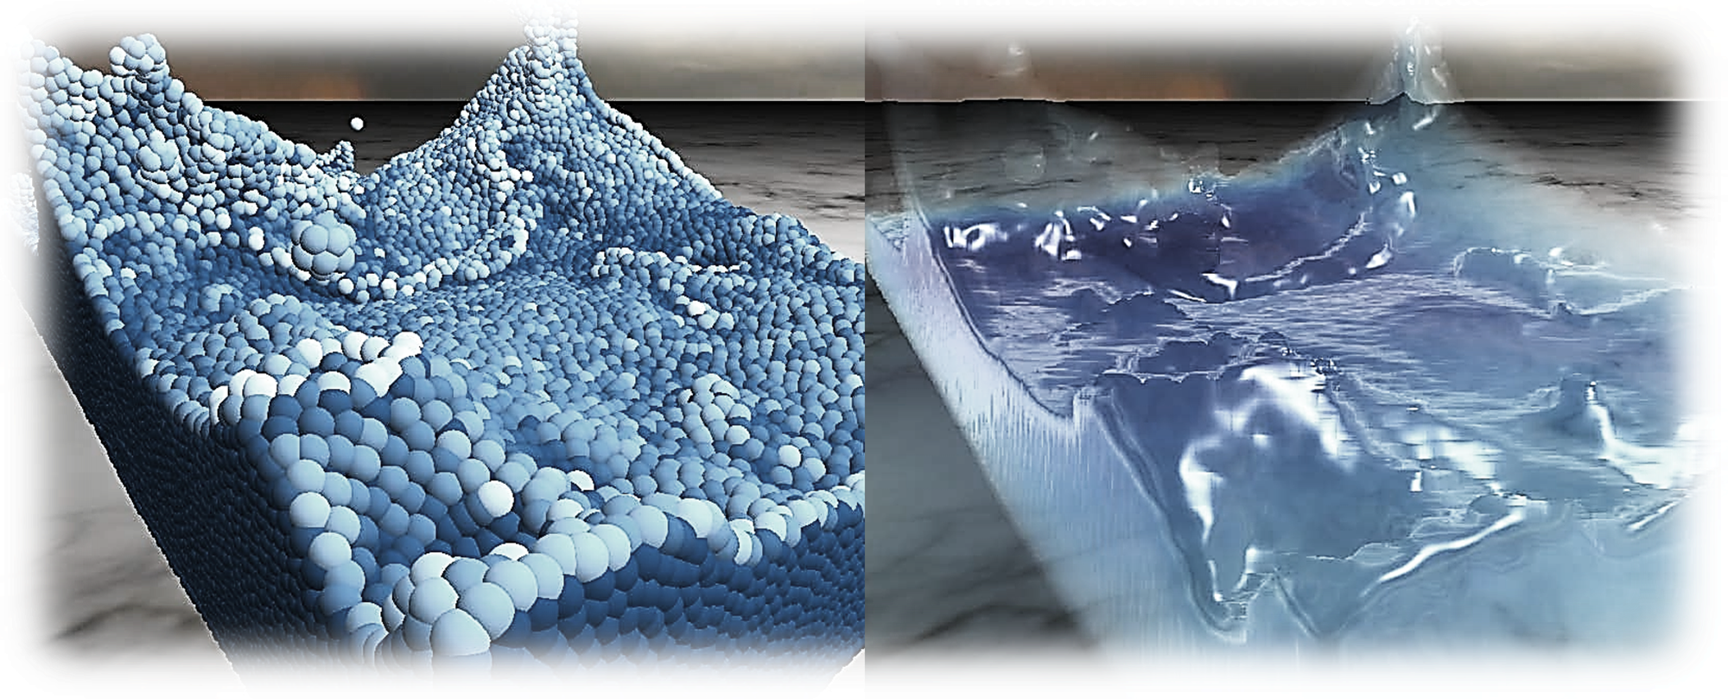
Fluid seen as particles
Simulation forces:
Forming small deformable clusters of particles
Constructing isosurfaces of clusters:
Challenges in real time:
Pressure | Viscosity | Surface tension | Interactions
Marching Cubes | Point Splats
Large no. of particles | Numerous terms in Navier Stokes Eq.
Interactive speed | Handled by independent threads
https://developer.nvidia.com/content/fluid-simulation-alice-madness-returns

Slide 6
SPH: introduction
Introduced in ’70s to simulate astronomical fissions and collisions [Lucy, Gingold]
People utilized it to simulate flow: fluidic, granular or even deformable objects
Quantities derived from neighbors by interpolating
Density formulation:
Smoothed quantity:
Kernels are smoothening functions:
Various forces are smoothed according to the complexity of fluid, or granularity, and added to NSE

Slide 7
SPH: Navier-Stokes equations
Navier-stokes equations (NSE) for in-compressible flow:
SPH approximates NSE on a set of particles: providing fluid appearance [Muller 03]
For an instant of time the spatial derivative only affects kernel (spatially varying)

Slide 8
SPH: forces in N-S equations
Pressure:
Viscous force:
Surface tension:
Where:
Adhesion:

Slide 9
SPH: kernels
All kernels are discussed by Muller[2] and Brian [8]
Density and surface tension kernel
Pressure kernel
Viscosity kernel
Adhesion kernel

Slide 10
User interactions
Challenges in real time:
Visual interface ~ 30 – 60 fps {mouse keyboard}
Haptic interface ~ 500 – 1000 KHz {Novint Falcon(3DoF)}
f term in NSE takes care of this force
Haptics incorporation:
Hardware update rate kept constant at 1000KHz
Still force update rate is limited by rendering lag
Can be reduced by
M.Tech 1st Stage Electrical Engineering, IIT Bombay

Slide 11
Fluid – rigid interaction
Forces and torques
Haptics incorporation
M.Tech 1st Stage Electrical Engineering, IIT Bombay

Slide 12
Visual rendering of fluids
Marching cubes and Point splats
Achieving interactive rates using CUDA
M.Tech 1st Stage Electrical Engineering, IIT Bombay

Slide 13
Implementation – steps
Collision Processing { accumulate force from neighbors, collider, walls }
Pressure (damped spring)
Shear (viscosity)
Integration { position ← velocity ← force }
Change in velocity ← accumulated force
Position ← simulation time step * velocity
Grid update { position and velocity are sorted according to grid index }
Fast radix sorting and update to new
Improve memory access coherence
Attraction (after collision)
If proxy collision detected: non-zero collider forces sent to host for accumulation

Slide 14

Implementation – source of forces I
Pressure, collide attraction {adhesion} and shear {viscosity} from other particles
DEM :
Forces interpolated from box kernel :
Max 26 immediate neighbors of each :
Influence: Iff nbd ≠ empty :
Nbd forces accumulated :
SPH with forces* from nbd with box kernel ↔ DEM
P_{i}
* Forces integrated to attributes, interpolated to fixed grid position. Forces composed of pressure, viscosity and adhesion

Slide 15
Implementation – source of forces II
Pressure, collide attraction {adhesion} and shear {viscosity} from collider
Pressure from boundary wallss | Collider force
Damped spring force | Pressure, attraction and shearing
Wall
F_{P}
Ci
P_{i}
P_{i}

Slide 16
Implementation – CUDA
Particle attributes {graphical rendering} : sorted position and velocity
Collider attribute {haptic rendering} : force from particle collision
Independent CUDA threads computed at one time instant
Particles : accumulated forces integrate to attributes
Collider : accumulated forces sent to haptic rendering
Particle attribute calculation : occupy one CUDA thread per particle
Collider force accumulation : occupy one CPU thread
Grid interpolation & sorting : occupy one CUDA thread per particle

Slide 17
Implementation – steps
Collision Processing { accumulate force from neighbors, collider, walls }
Pressure (damped spring)
Shear (viscosity)
Integration { position ← velocity ← force }
Change in velocity ← accumulated force
Position ← simulation time step * velocity
Grid update { position and velocity are sorted according to grid index }
Fast radix sorting and update to new
Improve memory access coherence
Attraction (after collision)
If proxy collision detected: non-zero collider forces sent to host for accumulation

Slide 18
Implementation: graphical rendering
Particle attribute calculation
Grid interpolation and sorting without transferring to host
Storing attributes in device memory, to send directly for graphical rendering
Positions allocated as float4arrays, in OpenGL vertex array object (VBO)
VBO is mapped for use by CUDA GL for rendering @ 20-100 fps

Slide 19
Implementation: haptic rendering
A haptic force field is constructed from collider force
Force field is buffered and fed to a Novint Falcon haptic device
Collider attribute calculation in a cpu thread

Slide 20
Implementation: Results
Cluster formation
Sticky collider
Haptic proxy
M.Tech 1st Stage Electrical Engineering, IIT Bombay

Slide 21
Future aspects: SPH incorporation
Normal fluids
Granular solids
M.Tech 1st Stage Electrical Engineering, IIT Bombay

Slide 22
Future Aspects: SPH incorporation
DEM mixing with SPH
Normal fluids
Granular solids
Challenges and moving to openhaptics
M.Tech 1st Stage Electrical Engineering, IIT Bombay

Slide 23
Future aspects: graphical rendering
Fluid appearances
1-2 pictures
M.Tech 1st Stage Electrical Engineering, IIT Bombay

Slide 24
Proposals: interactive mixing of fluids and solids
Introducing different particulate matter in different data structures
Different fluids mixing
Granular solids mixing with fluids
Deformable objects interaction
Haptics incorporation with all
Challenges to do so
M.Tech 1st Stage Electrical Engineering, IIT Bombay

Slide 25
Thank you

Slide 26
Building uniform grids

Slide 27
Simulation parameters
Grid size vs particle size choice and collider choice

Slide 28
V_{AB}
V_{AB}^{Tan}
V_{B}
V_{A}
V_{AB}^{Nor}
B, R_{B}
F_{a}
|P_{AB}|
F_{P}
A, R_{A}
P_{AB}
P_{A}
F_{sh}
P_{B}
O

Slide 29
Ci
P_{i}
P_{i}
Wall
F_{P}
P_{i}

Slide 30
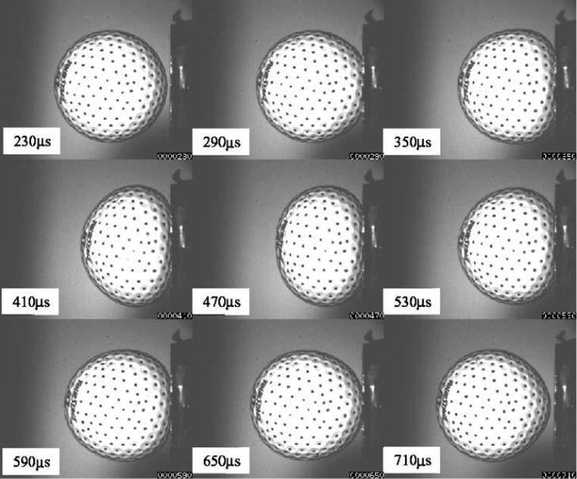
http://physics.stackexchange.com/users/9887/alfred-centauri
VIP Lab
EE, IIT Bombay

Slide 31
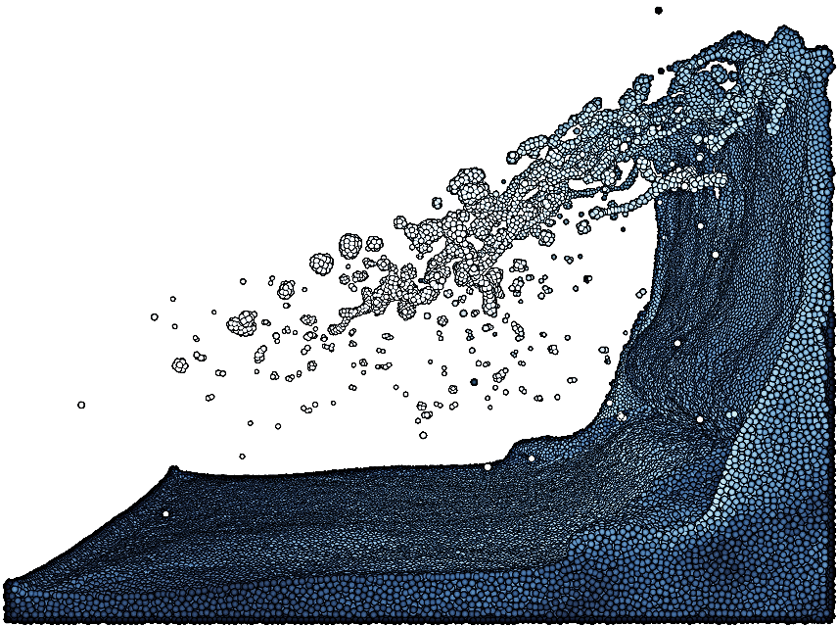
R. Winchenbach and et al, “Constrained Neighbor Lists for SPH-based Fluid Simulations“, ACM SIGGRAPH 2016

Slide 32
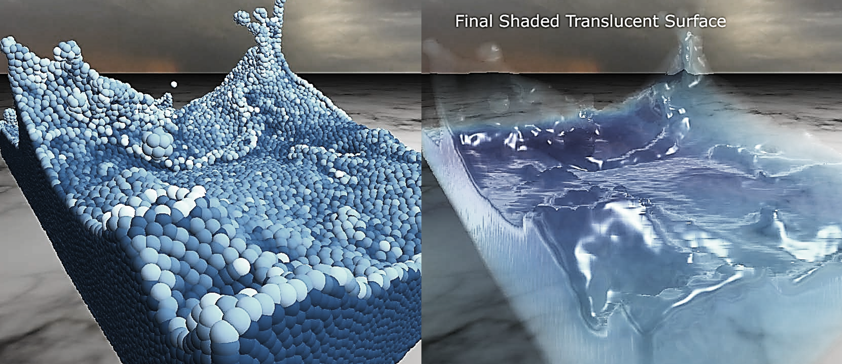

Slide 33
Collision Processing { accumulate force from neighbors, collider, walls }
Pressure (damped spring)
Shear (viscosity)
Integration { position ← velocity ← force }
Change in velocity ← accumulated force
Position ← simulation time step * velocity
Grid update { position and velocity are sorted according tor grid index }
Fast radix sorting
Improve memory access coherence
Attraction (after collision)
If proxy collision detected: non-zero collider forces sent to host for accumulation

